Slide 1

AGI Week-2 presentation

Slide 2
Topics
Feedback
Types
Feedback Loops
Comparison
Reinforcement Learning
Introduction
Q-learning algorithm
Mental Causation via Neuroprosthetics
Using feedback loops
M,N and B variables
Execution Plan
Designing algorithm

Slide 3
Feedback
Types
Feedback Loops
Comparison

Slide 4

types
Positive :- unstable and increases the level of output
Negative :- stable and maintains equilibrium state

Slide 5
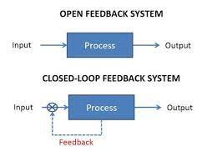
Feedback loops
Closed :- Feedback from the output is fed again and again that results in getting efficient Model
Open :- There is no loop

Slide 6

Flowchart
Sensory signals from Robotic Arm to Neuroprosthesis
Activate Neural activity pattern that realizes the intention
Mental Causation
Action signals(Motor signals)
Are released which are identified and decoded at Neuroprosthesis and redirects motor signals to the Arm
Action performs and feedback is sent to the Neuroprosthesis

Slide 7

Reinforcement Learning
Define
a machine learning training method based on rewarding desired behaviors and/or punishing undesired ones
Agent
Agent is able to perceive and interpret its environment, take actions and learn through trial and error
Memory
Agent learns from previous actions using memory

Slide 8
Q-Learning
Q-Learning
Uses Q-values to Improve the behavior.
Initially agent takes random moves and calculates the Q values.
Learns from Q values to take the next best state.
After many iterations agent adapts to the environment

Slide 9
Q Learning Algorithm
Uses Q-values to Improve the behavior.
Initially agent takes random moves and calculates the Q values.
Learns from Q values to take the next best state.
After many iterations agent adapts to the environment
To have an idea of previous actions and rewards we keep Q matrix as memory that stores all Q values of current state for every action.
Implementation
Agent takes certain episode first to learn the environment where episode means a sequence of State – Action – Reward. Thus we will have Q values and stored in a table.
Now we update Q values at each time using the following Bellman Optimality Equation

Slide 10
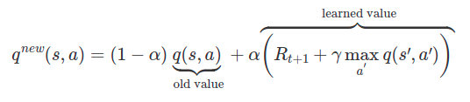
Where,
q (s, a) = old Q value stored in table.
q^{new}(s, a) = Updated Q values by taking Action ‘a’ to reach state ‘s’.
α = Learning rate.
r = Discounting Factor for future Rewards.
R_{t+1} = Reward till now
S’ = next state
a’ = action taken to reach state s’

Slide 11
Thus, if we specify episodes = 1000 then the agent trains by performing all episodes and adapts to the environment, and as a result it has well defined and efficient Q values that gathered through all episodes and stores in a memory, which shows efficient actions to take.
Now the model is ready to compete in that environment.
Efficiency α No of Episodes (directly proportional), so more episodes gives more information about the environment and agent will also become more suitable for the environment.

Slide 12


